Slide 1
RUSTikales Rust for beginners

Slide 2
Plan for today

Slide 3
Plan for today
Recap

Slide 4
Plan for today
Recap
Loops

Slide 5
Recap

Slide 6
Recap
Integers in Rust: i8, u8, i16, u16, ... , i128, u128

Slide 7
Recap
Integers in Rust: i8, u8, i16, u16, ... , i128, u128
let <name> = ...; to declare an immutable variable
let mut <name> = ...; to declare a mutable variable

Slide 8
Recap
Integers in Rust: i8, u8, i16, u16, ... , i128, u128
let <name> = ...; to declare an immutable variable
let mut <name> = ...; to declare a mutable variable
let var: [type; size] = ...; to declare an array with the given type and size
let var: Vec<type> = ...; to declare a Vector with the given type

Slide 9
Recap
Integers in Rust: i8, u8, i16, u16, ... , i128, u128
let <name> = ...; to declare an immutable variable
let mut <name> = ...; to declare a mutable variable
let var: [type; size] = ...; to declare an array with the given type and size
let var: Vec<type> = ...; to declare a Vector with the given type
Elements in Arrays and Vectors always have the same type

Slide 10
Recap
Integers in Rust: i8, u8, i16, u16, ... , i128, u128
let <name> = ...; to declare an immutable variable
let mut <name> = ...; to declare a mutable variable
let var: [type; size] = ...; to declare an array with the given type and size
let var: Vec<type> = ...; to declare a Vector with the given type
Elements in Arrays and Vectors always have the same type
Arrays have a fixed size, Vectors are resizable

Slide 11
Recap
var[index] to access the element at a given index
  var[0] = 5; sets the element at index 0 to 5
  let x = var[1]; gets the element at index 1 and stores it in x

Slide 12
Recap
var[index] to access the element at a given index
Arrays and Vectors are zero-indexed
  For size N, indices 0 to N-1 are defined, anything else results in Out-Of-Bounds panics

Slide 13
Recap
var[index] to access the element at a given index
Arrays and Vectors are zero-indexed
vec![] is a macro to easily create Vectors

Slide 14
Recap
Important to know:

Slide 15
Recap
Important to know:
  Many helper methods exist for Arrays and Vectors
    name.reverse() reverses the order of elements in name, and stores the result in name again
    vector.pop() removes the last element of a Vector
    name.len() returns the number of elements in your Array/Vector

Slide 16
Recap
Important to know:
  Many helper methods exist for Arrays and Vectors
  Array Type Declaration itself is a Type

Slide 17
Recap
Important to know:
  Many helper methods exist for Arrays and Vectors
  Array Type Declaration itself is a Type
    [i32; 5] is an Array of i32
    [[i32; 5]; 5] is an Array of Arrays of i32
    Vec<[i32; 5]> is a Vector of Arrays of i32
    [Vec<i32>; 5] is an Array of Vectors of i32

Slide 18
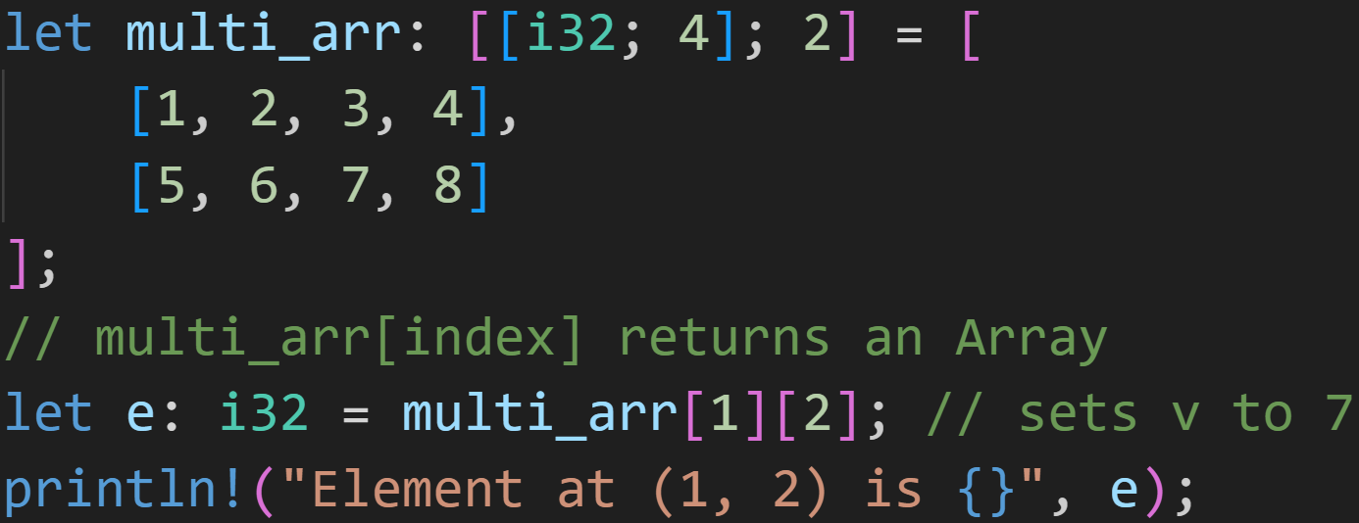
Recap

Slide 19
Recap
[5, 6, 7, 8]

Slide 20
Recap
[5, 6, 7, 8][2]

Slide 21
Recap
7

Slide 22
Recap
7

Slide 23
Loops
Note: I will use Arrays and Vectors interchangeably today

Slide 24
Loops
Writing code that fits a single Vector size is easy, but breaks once you modify its size

Slide 25
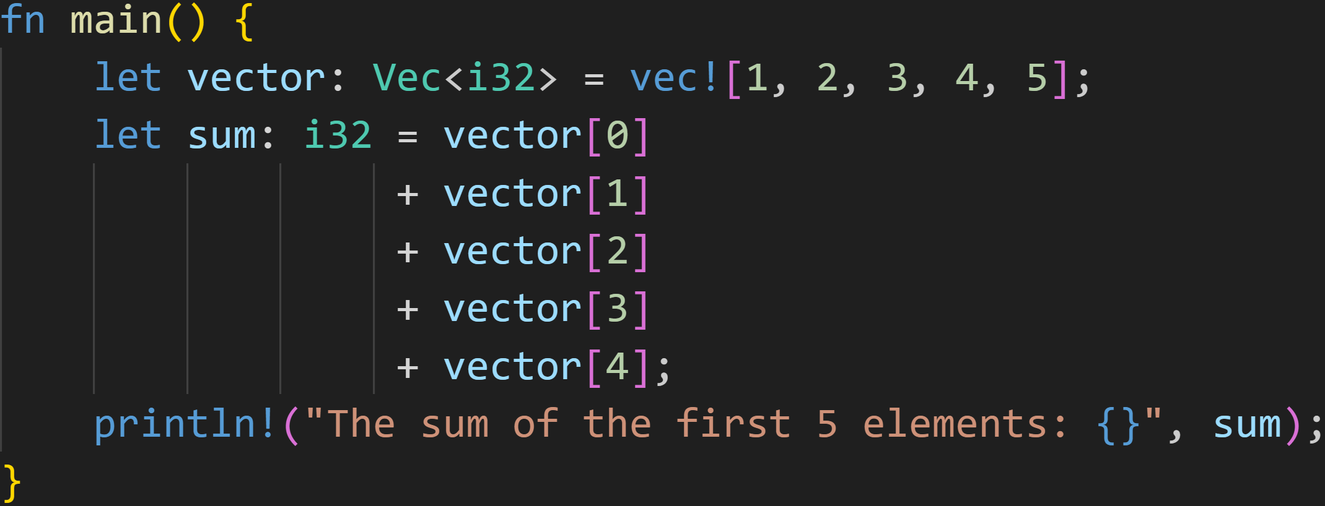
Loops
Writing code that fits a single Vector size is easy, but breaks once you modify its size

Slide 26
Loops
Writing code that fits a single Vector size is easy, but breaks once you modify its size
What happens if we add a 6th element?

Slide 27
Loops
Writing code that fits a single Vector size is easy, but breaks once you modify its size
What happens if we add a 6th element?
Write another line, easy!

Slide 28
Loops
Writing code that fits a single Vector size is easy, but breaks once you modify its size
What happens if we add a 6th element?
Write another line, easy!
Now do it for 1000 elements :^)

Slide 29
Loops
Writing code that fits a single Vector size is easy, but breaks once you modify its size
Sometimes you don‘t know its size, but want to do something for every element in it

Slide 30
Loops
Writing code that fits a single Vector size is easy, but breaks once you modify its size
Sometimes you don‘t know its size, but want to do something for every element in it
Sometimes you want to go over a range of numbers, and do something for every number

Slide 31
Loops
Writing code that fits a single Vector size is easy, but breaks once you modify its size
Sometimes you don‘t know its size, but want to do something for every element in it
Sometimes you want to go over a range of numbers, and do something for every number
  For every number below 1000, print the primes :)

Slide 32
Loops
Writing code that fits a single Vector size is easy, but breaks once you modify its size
Sometimes you don‘t know its size, but want to do something for every element in it
Sometimes you want to go over a range of numbers, and do something for every number
  For every number below 1000, print the primes :)
  Play a game of FizzBuzz

Slide 33
Loops
Writing code that fits a single Vector size is easy, but breaks once you modify its size
Sometimes you don‘t know its size, but want to do something for every element in it
Sometimes you want to go over a range of numbers, and do something for every number
  For every number below 1000, print the primes :)
  Play a game of FizzBuzz
    For every number below 100:
      if number is divisible by 3, print „Fizz“
      if number is divisible by 5, print „Buzz“
      if number is divisible by 15, print „FizzBuzz“
      else print the number

Slide 34
Loops
Writing code that fits a single Vector size is easy, but breaks once you modify its size
Sometimes you don‘t know its size, but want to do something for every element in it
Sometimes you want to go over a range of numbers, and do something for every number
  For every number below 1000, print the primes :)
  Play a game of FizzBuzz
    For every number below 100:
      if number is divisible by 3, print „Fizz“
      if number is divisible by 5, print „Buzz“
      if number is divisible by 15, print „FizzBuzz“
      else print the number

Slide 35
Loops
Writing code that fits a single Vector size is easy, but breaks once you modify its size
Sometimes you don‘t know its size, but want to do something for every element in it
Sometimes you want to go over a range of numbers, and do something for every number
Need to do any of that? Loops are your friend!

Slide 36
Loops
A Loop does exactly what you think it does → It loops a piece of code

Slide 37
Loops
A Loop does exactly what you think it does → It loops a piece of code
There are many types of loops
  loop
  while
  for

Slide 38
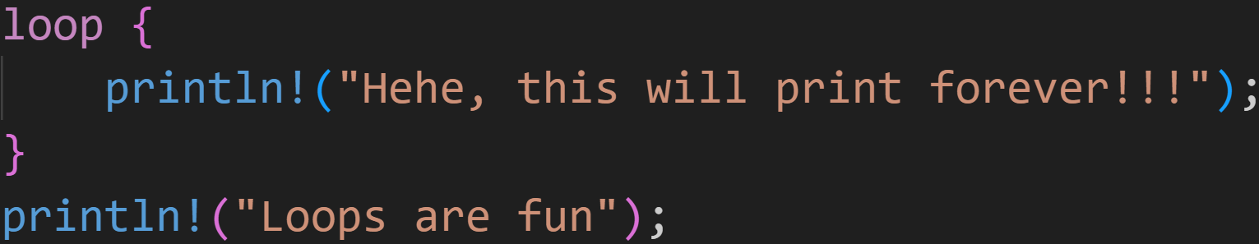
Loops
A Loop does exactly what you think it does → It loops a piece of code
There are many types of loops

Slide 39
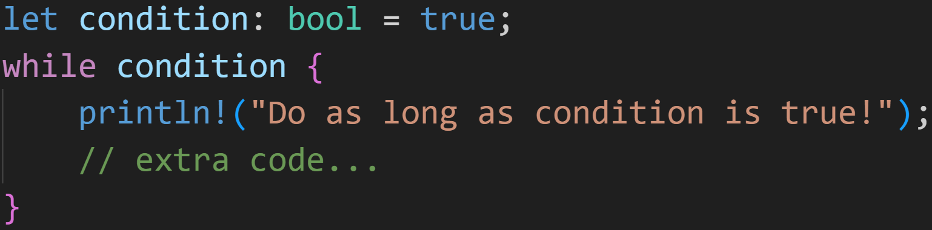
Loops
A Loop does exactly what you think it does → It loops a piece of code
There are many types of loops

Slide 40
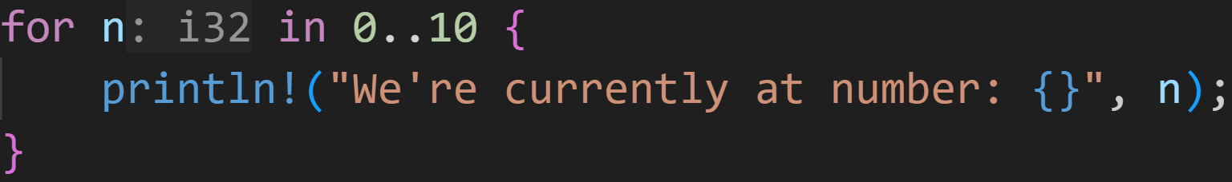
Loops
A Loop does exactly what you think it does → It loops a piece of code
There are many types of loops

Slide 41
Loops
A Loop does exactly what you think it does → It loops a piece of code
There are many types of loops
Each type has their own use cases

Slide 42
Loops
A Loop does exactly what you think it does → It loops a piece of code
There are many types of loops
Each type has their own use cases
  Use loop if you know that your loop never stops

Slide 43
Loops
A Loop does exactly what you think it does → It loops a piece of code
There are many types of loops
Each type has their own use cases
  Use loop if you know that your loop never stops
    A server will never stop listening to requests

Slide 44
Loops
A Loop does exactly what you think it does → It loops a piece of code
There are many types of loops
Each type has their own use cases
  Use loop if you know that your loop never stops
  Use while if you want to loop based on a condition

Slide 45
Loops
A Loop does exactly what you think it does → It loops a piece of code
There are many types of loops
Each type has their own use cases
  Use loop if you know that your loop never stops
  Use while if you want to loop based on a condition
    While there are elements in this set, do X

Slide 46
Loops
A Loop does exactly what you think it does → It loops a piece of code
There are many types of loops
Each type has their own use cases
  Use loop if you know that your loop never stops
  Use while if you want to loop based on a condition
  Use for if you want to iterate* over a collection

Slide 47
Loops
A Loop does exactly what you think it does → It loops a piece of code
There are many types of loops
Each type has their own use cases
  Use loop if you know that your loop never stops
  Use while if you want to loop based on a condition
  Use for if you want to iterate* over a collection
    For every number in a range
    For every element in a Vector
    For every dog in my local park

Slide 48
Loops - loop
loop is the simplest form of loops in Rust

Slide 49
Loops - loop
loop is the simplest form of loops in Rust
It‘s also pretty dumb, it can not stop, ever*

Slide 50
Loops - loop
loop is the simplest form of loops in Rust
It‘s also pretty dumb, it can not stop, ever*
Use cases include:

Slide 51
Loops - loop
loop is the simplest form of loops in Rust
It‘s also pretty dumb, it can not stop, ever*
Use cases include:
  You don‘t want your code to ever stop
    Servers listen to requests 24/7

Slide 52
Loops - loop
loop is the simplest form of loops in Rust
It‘s also pretty dumb, it can not stop, ever*
Use cases include:
  You don‘t want your code to ever stop
  Your while-condition would be too complex to put in one expression
    Instead, you can split it into sub-expressions and test each of them separately

Slide 53
Loops - loop
loop is the simplest form of loops in Rust
It‘s also pretty dumb, it can not stop, ever*
Use cases include:
  You don‘t want your code to ever stop
  Your while-condition would be too complex to put in one expression
  Stress Testing your CPU (simplest way of getting 100% usage)

Slide 54
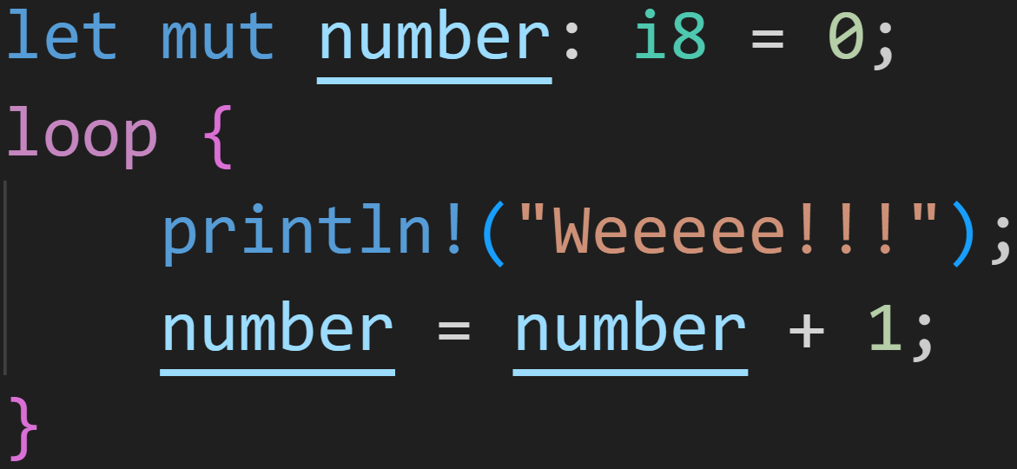
Loops - loop
a loop loop may look like this

Slide 55
Loops - loop
a loop loop may look like this
Body of the loop
→ This part gets repeated

Slide 56
Loops - loop
a loop loop may look like this
increments this variable

Slide 57
Loops - loop
a loop loop may look like this
Debug mode → Crash once number is 127

Slide 58
Loops - loop
a loop loop may look like this
0/3
Debug mode → Crash once number is 127
Why?

Slide 59
Loops - loop
a loop loop may look like this
0/3
Debug mode → Crash once number is 127
Why?
→ i8 can only store up to 127, Overflow

Slide 60
Loops - loop
a loop loop may look like this
Debug mode → Crash once number is 127
Release mode → Wrap to -128 and continue

Slide 61
Loops - while
while is the advanced version of loop

Slide 62
Loops - while
while is the advanced version of loop
whereas loop loops forever, while stops once a condition is no longer satisfied

Slide 63
Intermission - Conditions
Conditions are expressions which return a boolean (either true or false)

Slide 64
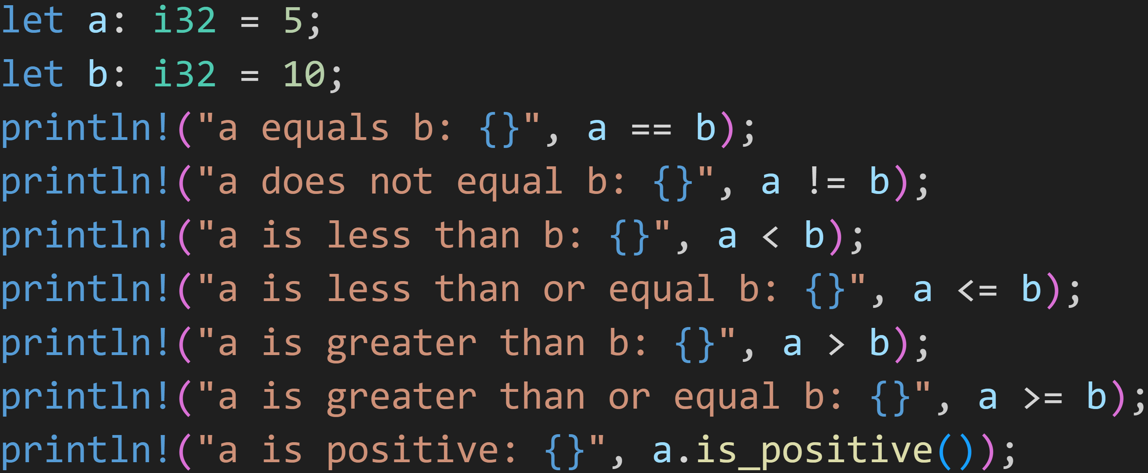
Intermission - Conditions

Slide 65
Intermission - Conditions
Those expressions return true or false

Slide 66
Intermission - Conditions
1/3
What does the program output?

Slide 67
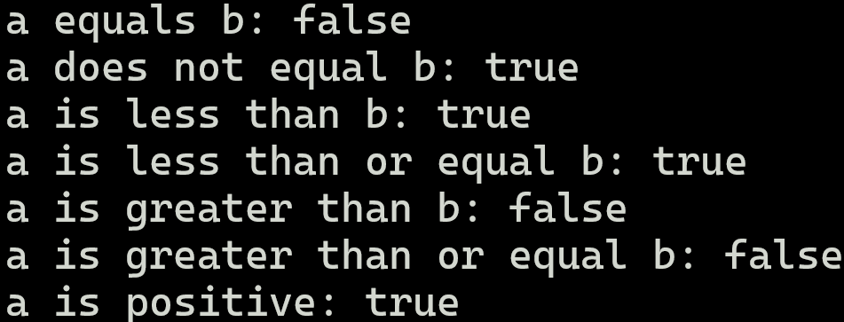
Intermission - Conditions

Slide 68
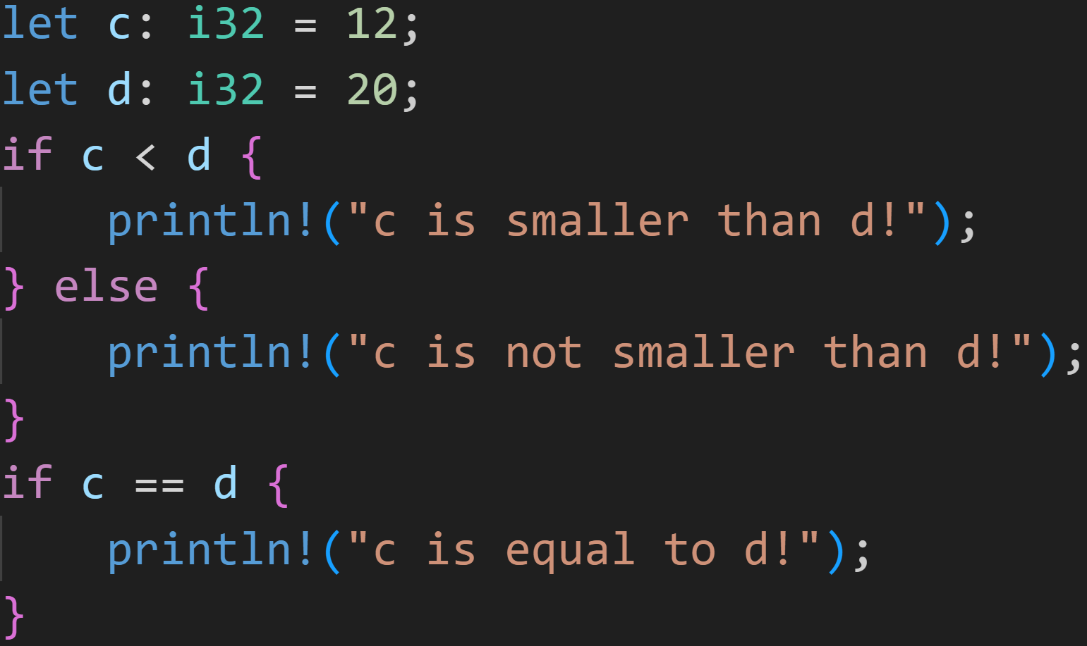
Intermission - Conditions

Slide 69
Intermission - Conditions
if-expression:
if the condition is true, do the thing in the block

Slide 70
Intermission - Conditions
if-expression:
if the condition is true, do the thing in the block
else, do the thing in the other block

Slide 71
Intermission - Conditions
else is optional → We simply do nothing if the condition is false

Slide 72
Intermission - Conditions
1/3
What does the program print?

Slide 73
Intermission - Conditions
1/3
What does the program print?
true
false

Slide 74
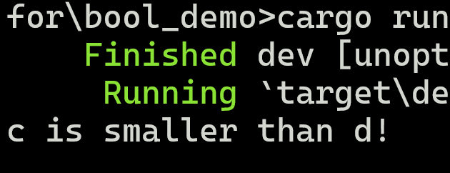
Intermission - Conditions
We only get one line of output
1/3
true
false

Slide 75
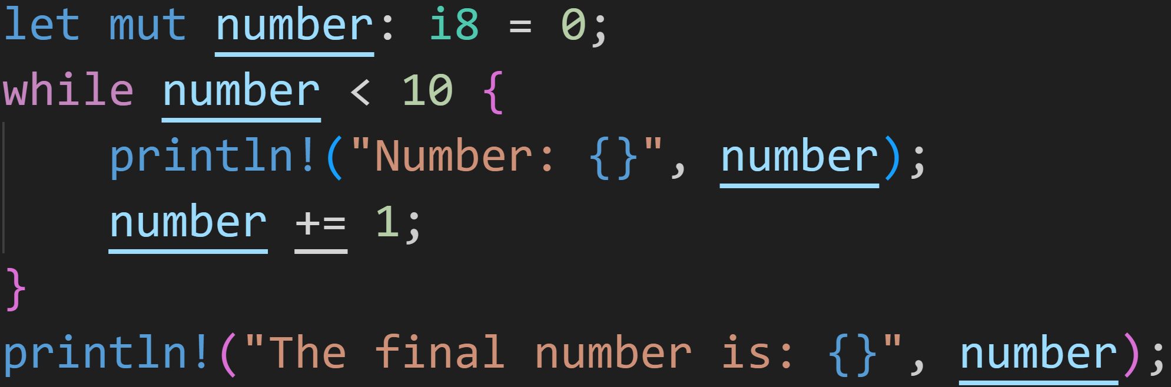
Loops - while
a while loop may look like this

Slide 76
Loops - while
a while loop may look like this
while the condition is true (number is smaller than 10),

Slide 77
Loops - while
a while loop may look like this
while the condition is true (number is smaller than 10), do the things in the block

Slide 78
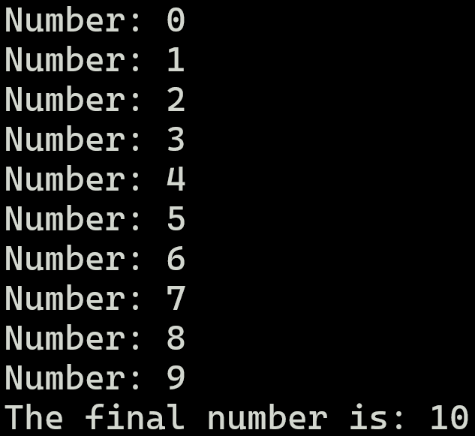
Loops - while
a while loop may look like this

Slide 79
Loops - while
a while loop may look like this
10 is not less than 10, so it does not enter the loop again

Slide 80
Intermission - Scopes

Slide 81
Intermission - Scopes
Statements wrapped in curly brackets are called code blocks

Slide 82
Intermission - Scopes
Statements wrapped in curly brackets are called code blocks
Each Block has a scope in which it operates

Slide 83
Intermission - Scopes
Statements wrapped in curly brackets are called code blocks
Each Block has a scope in which it operates
Blocks can access variables from outer scopes

Slide 84
Intermission - Scopes
Statements wrapped in curly brackets are called code blocks
Each Block has a scope in which it operates
Blocks can access variables from outer scopes
Variables can only be used in scopes they‘re defined in
  They‘re dropped once we leave the scope

Slide 85
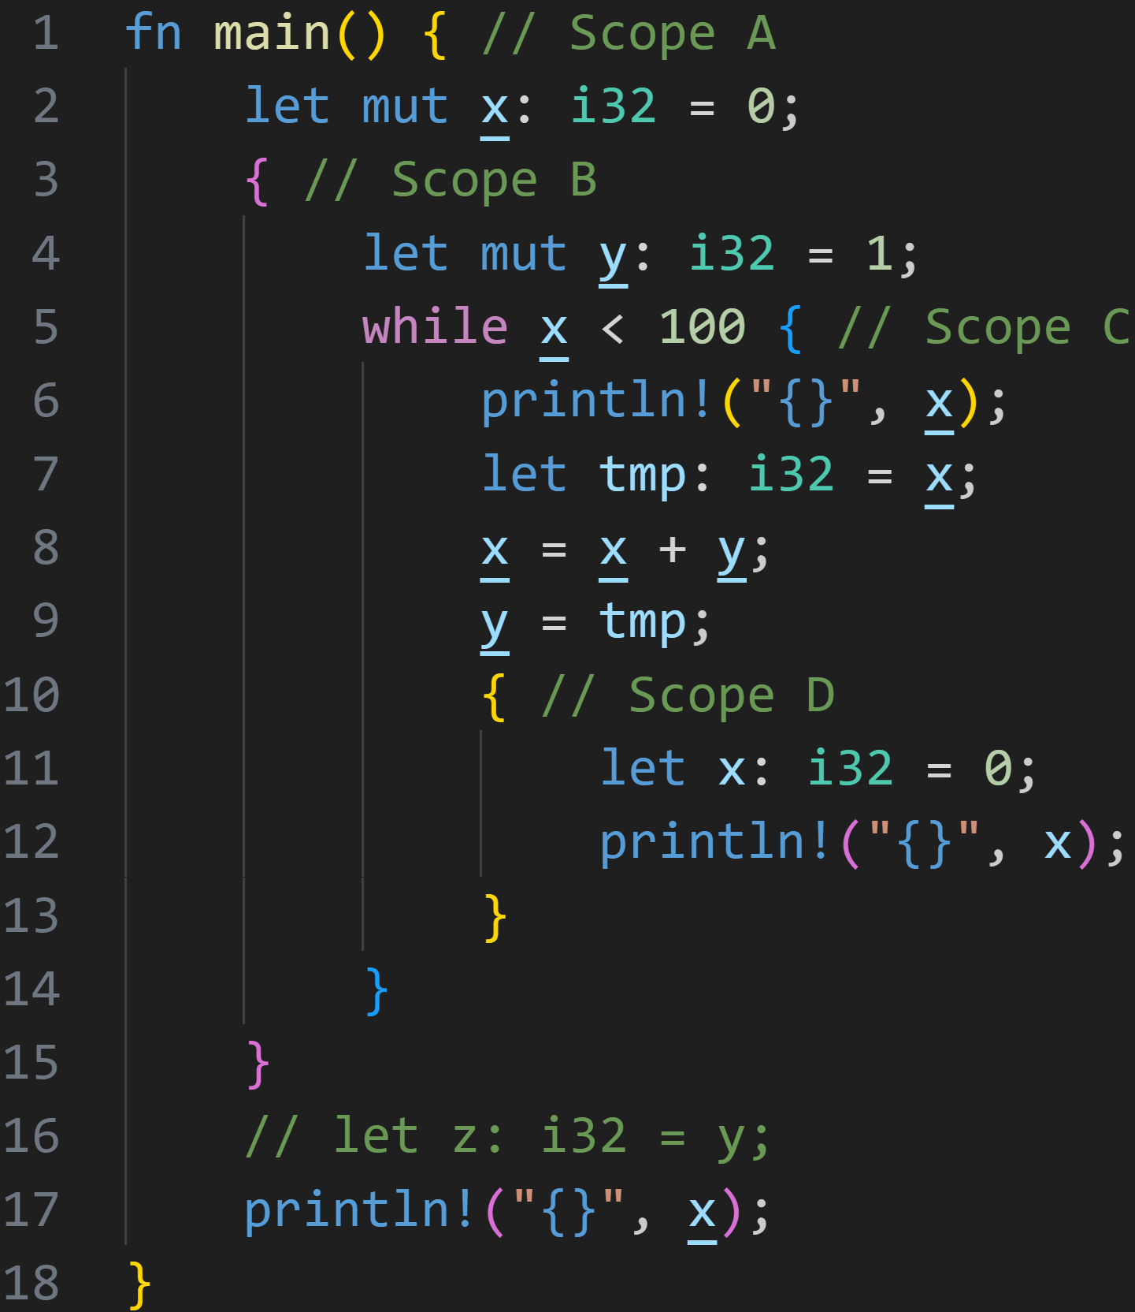
Intermission - Scopes

Slide 86
Intermission - Scopes
Scope | Variables
A

Slide 87
Intermission - Scopes
Scope | Variables
A | x = 0

Slide 88
Intermission - Scopes
Scope | Variables
A | x = 0
B

Slide 89
Intermission - Scopes
Scope | Variables
A | x = 0
B | y = 1

Slide 90
Intermission - Scopes
Scope | Variables
A | x = 0
B | y = 1
Check current scope
→ No x found in B
→ Check previous scope

Slide 91
Intermission - Scopes
Scope | Variables
A | x = 0
B | y = 1
Uses x from Scope A

Slide 92
Intermission - Scopes
Scope | Variables
A | x = 0
B | y = 1
C

Slide 93
Intermission - Scopes
Scope | Variables
A | x = 0
B | y = 1
C
Uses x from Scope A

Slide 94
Intermission - Scopes
Scope | Variables
A | x = 0
B | y = 1
C | tmp = 0
Uses x from Scope A

Slide 95
Intermission - Scopes
Scope | Variables
A | x = 1
B | y = 1
C | tmp = 0
Uses x from Scope A
Uses y from Scope B

Slide 96
Intermission - Scopes
Scope | Variables
A | x = 1
B | y = 0
C | tmp = 0
Uses x from Scope A
Uses y from Scope B

Slide 97
Intermission - Scopes
Scope | Variables
A | x = 1
B | y = 0
C | tmp = 0
D

Slide 98
Intermission - Scopes
Scope | Variables
A | x = 1
B | y = 0
C | tmp = 0
D | x = 0

Slide 99
Intermission - Scopes
Scope | Variables
A | x = 1
B | y = 0
C | tmp = 0
D | x = 0
x is defined in the current scope, use this one!
→ Variable shadowing

Slide 100
Intermission - Scopes
Scope | Variables
A | x = 1
B | y = 0
C | tmp = 0

Slide 101
Intermission - Scopes
Scope | Variables
A | x = 1
B | y = 0

Slide 102
Intermission - Scopes
Scope | Variables
A | x = 1
B | y = 0
Check condition again, and repeat until it is no longer true

Slide 103
Intermission - Scopes
Scope | Variables
A | x = 1
B | y = 1
Check condition again, and repeat until it is no longer true

Slide 104
Intermission - Scopes
Scope | Variables
A | x = 2
B | y = 1
Check condition again, and repeat until it is no longer true

Slide 105
Intermission - Scopes
Scope | Variables
A | x = 3
B | y = 2
Check condition again, and repeat until it is no longer true

Slide 106
Intermission - Scopes
Scope | Variables
A | x = 5
B | y = 3
Check condition again, and repeat until it is no longer true

Slide 107
Intermission - Scopes
Scope | Variables
A | x = 8
B | y = 5
Check condition again, and repeat until it is no longer true

Slide 108
Intermission - Scopes
Scope | Variables
A | x = 13
B | y = 8
Check condition again, and repeat until it is no longer true

Slide 109
Intermission - Scopes
Scope | Variables
A | x = 89
B | y = 55
Check condition again, and repeat until it is no longer true
Eventually...

Slide 110
Intermission - Scopes
Scope | Variables
A | x = 144
B | y = 89
Check condition again, and repeat until it is no longer true
Eventually...
144 is not smaller than 100!

Slide 111
Intermission - Scopes
Scope | Variables
A | x = 144
Check condition again, and repeat until it is no longer true
Eventually...
144 is not smaller than 100!
And we continue.

Slide 112
Intermission - Scopes
Scope | Variables
A | x = 144
The only valid Scope is A, which does not have y
→ Scope B did have y, but it ended in line 15
→ Scope B is not a previous scope of A :^)
→ This would be an error

Slide 113
Intermission - Scopes
Scope | Variables
A | x = 144
Prints 144

Slide 114
Intermission - Scopes
Scope | Variables

Slide 115
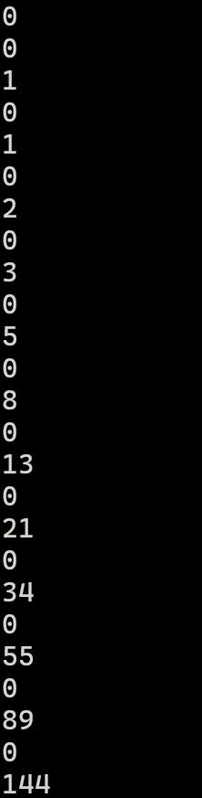
Intermission - Scopes
Output:

Slide 116
Loops - for
for is a very powerful loop

Slide 117
Loops - for
for is a very powerful loop
It allows you to comfortably loop over data collections

Slide 118
Loops - for
for is a very powerful loop
It allows you to comfortably loop over data collections
However, where power is involved, rules are necessary

Slide 119
Loops - for
for is a very powerful loop
It allows you to comfortably loop over data collections
However, where power is involved, rules are necessary
  To be able to use for on a collection, it needs to implement an Iterator-Trait

Slide 120
Loops - for
for is a very powerful loop
It allows you to comfortably loop over data collections
However, where power is involved, rules are necessary
  To be able to use for on a collection, it needs to implement an Iterator-Trait
  for implicitly turns your collections into iterators

Slide 121
Loops - for
for is a very powerful loop
It allows you to comfortably loop over data collections
However, where power is involved, rules are necessary
  To be able to use for on a collection, it needs to implement an Iterator-Trait
  for implicitly turns your collections into iterators
  If you‘re using the original collection, it gets moved and you can‘t use it anymore
    You have to borrow the collection to prevent that

Slide 122
Loops - for
for is a very powerful loop
It allows you to comfortably loop over data collections
However, where power is involved, rules are necessary
  To be able to use for on a collection, it needs to implement an Iterator-Trait
  for implicitly turns your collections into iterators
  If you‘re using the original collection, it gets moved and you can‘t use it anymore
    You have to borrow the collection to prevent that
What this means will be covered next week when we introduce the Ownership Model, for now most examples only work as isolated blocks :^)

Slide 123
Loops - for
for is a very powerful loop
It allows you to comfortably loop over data collections
However, where power is involved, rules are necessary
  To be able to use for on a collection, it needs to implement an Iterator-Trait
  for implicitly turns your collections into iterators
  If you‘re using the original collection, it gets moved and you can‘t use it anymore
    You have to borrow the collection to prevent that
What this means will be covered next week when we introduce the Ownership Model, for now most examples only work as isolated blocks :^)
  If you feel very brave, you can try and slap & in front of vectors when you use them in a for loop, and see what happens :^)

Slide 124
Loops - for
for is a very powerful loop
It allows you to comfortably loop over data collections
However, where power is involved, rules are necessary
  To be able to use for on a collection, it needs to implement an Iterator-Trait
  for implicitly turns your collections into iterators
  If you‘re using the original collection, it gets moved and you can‘t use it anymore
    You have to borrow the collection to prevent that
What this means will be covered next week when we introduce the Ownership Model, for now most examples only work as isolated blocks :^)
Iterators are scary and complex, we‘ll ignore most of it as long as possible and still have fun with our non-idiomatic code :)

Slide 125
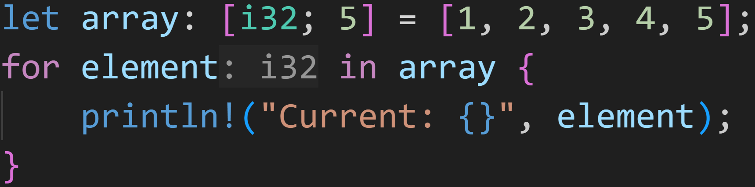
Loops - for
a for loop may look like this

Slide 126
Loops - for
a for loop may look like this
For every element in the array

Slide 127
Loops - for
a for loop may look like this
For every element in the array
do the stuff in the block

Slide 128
Loops - for
a for loop may look like this
Instead of using indices, the for loop automatically assigns the element to a variable, here called element

Slide 129
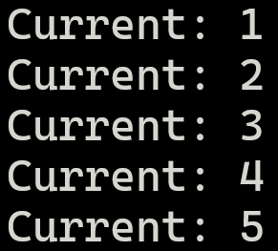
Loops - for
Output:
a for loop may look like this

Slide 130
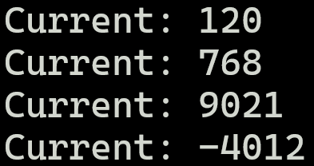
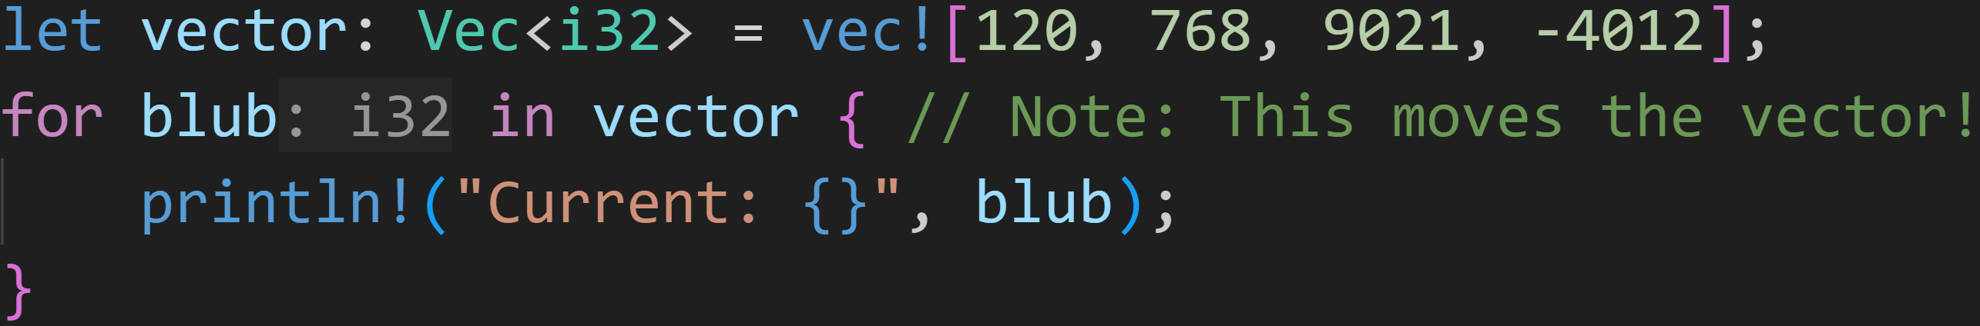
Loops - for
Output:
a for loop may look like this

Slide 131
Loops - for
Output:
a for loop may look like this
You can name the variable whatever you want

Slide 132
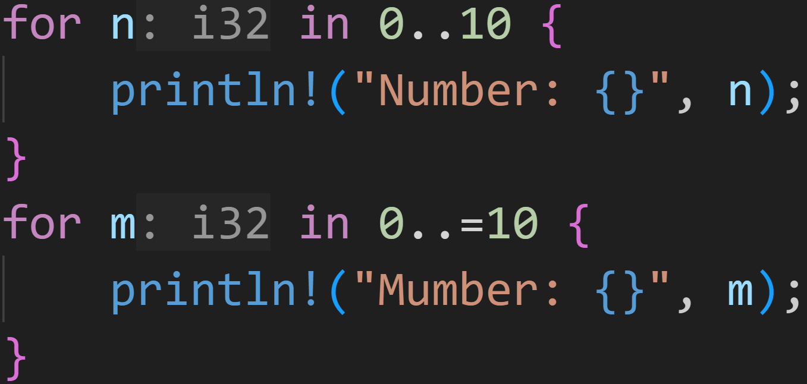
Loops - for
a for loop may look like this

Slide 133
Loops - for
Range operator
→ Creates a collection of numbers between start and end
a for loop may look like this

Slide 134
Loops - for
Range operator
→ Creates a collection of numbers between start and end
a for loop may look like this
end is NOT contained in that collection
end is contained in that collection

Slide 135
Loops - for
a for loop may look like this
n is in [0, 1, 2, 3, 4, 5, 6, 7, 8, 9]
m is in [0, 1, 2, 3, 4, 5, 6, 7, 8, 9, 10]

Slide 136
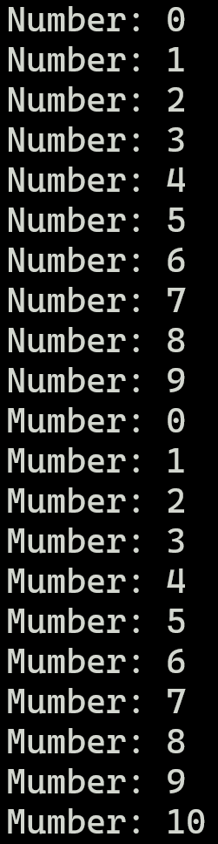
Loops - for
Output:
a for loop may look like this

Slide 137
Loops - for
Output:
a for loop may look like this

Slide 138
Loops - for
Output:
a for loop may look like this

Slide 139
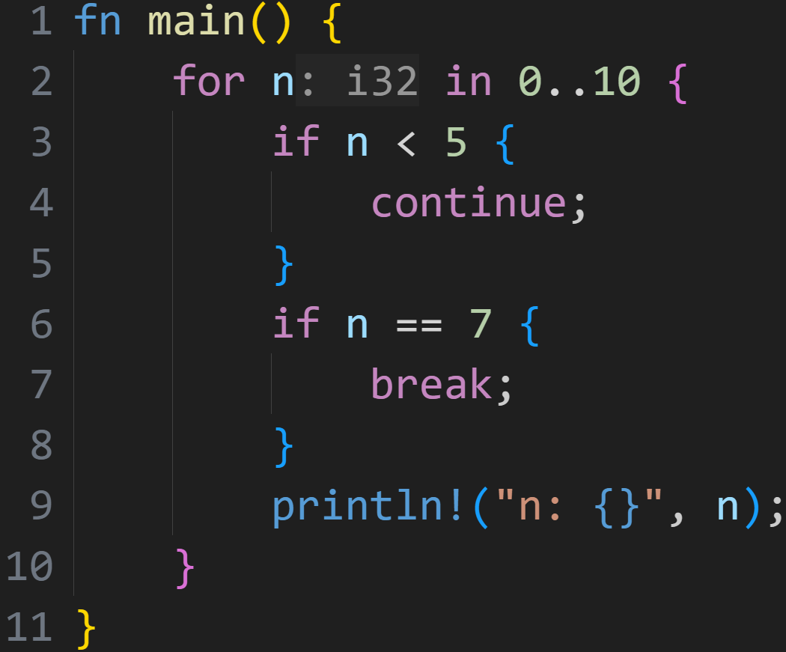
Loops - break and continue
For more control over loops, we can also use continue and break

Slide 140
Loops - break and continue
For more control over loops, we can also use continue and break
continue: Skip to the next iteration and jump to start of the loop block

Slide 141
Loops - break and continue
For more control over loops, we can also use continue and break
continue: Skip to the next iteration and jump to start of the loop block
break: Break out of the loop, jump behind the loop

Slide 142
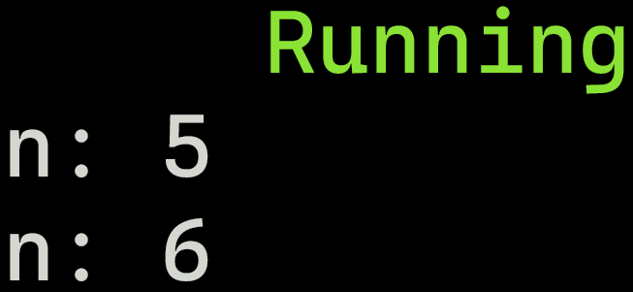
Loops - break and continue
For more control over loops, we can also use continue and break
continue: Skip to the next iteration and jump to start of the loop block
break: Break out of the loop, jump behind the loop
Output:

Slide 143
Loops - break and continue
n = [0, 1, 2, 3, 4] were skipped by the continue
we broke out of the loop at n = 7, before printing
Output:

Slide 144
Loops - break and continue
Output:

Slide 145
Loops - break and continue
Output:
n = 0

Slide 146
Loops - break and continue
Output:
n = 0

Slide 147
Loops - break and continue
Output:
n = 1

Slide 148
Loops - break and continue
Output:
n = 1

Slide 149
Loops - break and continue
Output:
n = 2

Slide 150
Loops - break and continue
Output:
n = 2

Slide 151
Loops - break and continue
Output:
n = 3

Slide 152
Loops - break and continue
Output:
n = 3

Slide 153
Loops - break and continue
Output:
n = 4

Slide 154
Loops - break and continue
Output:
n = 4

Slide 155
Loops - break and continue
Output:
n = 5

Slide 156
Loops - break and continue
Output:
n = 5

Slide 157
Loops - break and continue
Output:
n = 5

Slide 158
Loops - break and continue
Output:
n = 5

Slide 159
Loops - break and continue
Output:
n = 6

Slide 160
Loops - break and continue
Output:
n = 6

Slide 161
Loops - break and continue
Output:
n = 6

Slide 162
Loops - break and continue
Output:
n = 6

Slide 163
Loops - break and continue
Output:
n = 7

Slide 164
Loops - break and continue
Output:
n = 7

Slide 165
Loops - break and continue
Output:
n = 7

Slide 166
Loops - break and continue
Output:

Slide 167
Intermission - Exercises
Time for exercises!

Slide 168
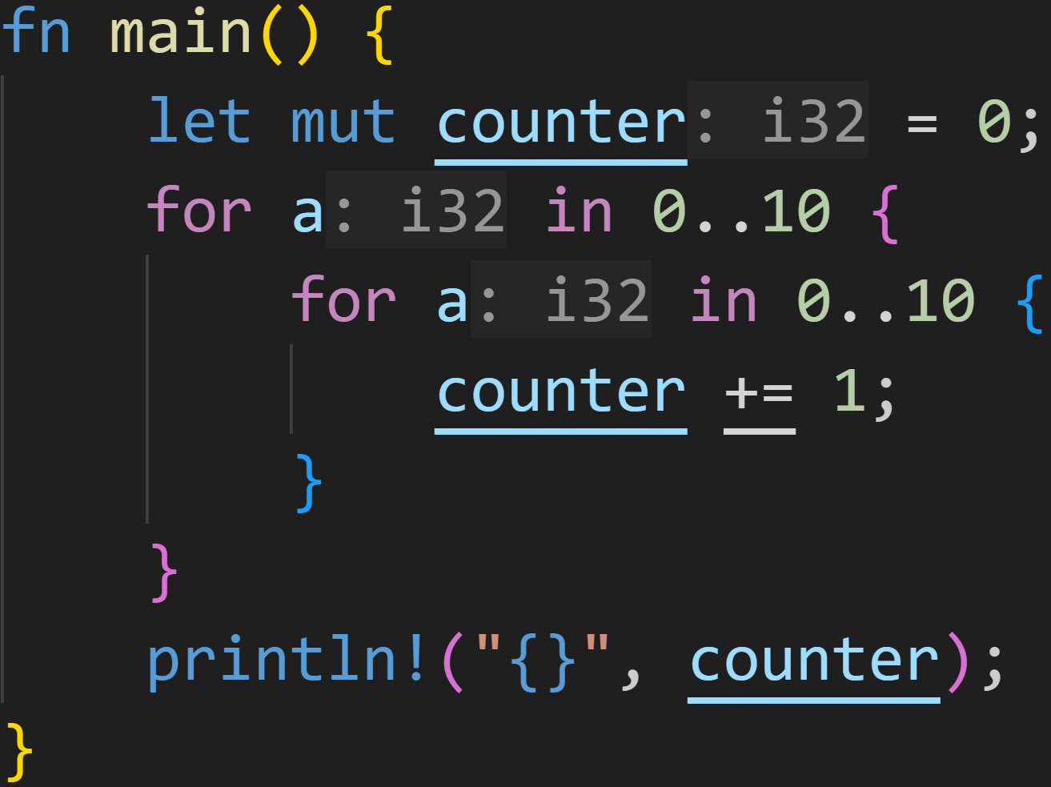
Intermission - Exercises
2/3

Slide 169
Intermission - Exercises
2/3
Does this code compile?
If yes, what does it print?

Slide 170
Intermission - Exercises
2/3
Does this code compile?
If yes, what does it print?
It does compile!

Slide 171
Intermission - Exercises
2/3
Does this code compile?
If yes, what does it print?
It does compile!
The answer is 100.

Slide 172
Intermission - Exercises
2/3
Does this code compile?
If yes, what does it print?
It does compile!
The answer is 100.
When nesting loops, runtime easily blows up

Slide 173
Intermission - Exercises
2/3
Does this code compile?
If yes, what does it print?
It does compile!
The answer is 100.
When nesting loops, runtime easily blows up
→ For every outer loop you need to run the inner loop 10 times

Slide 174
Intermission - Exercises
2/3
Does this code compile?
If yes, what does it print?
It does compile!
The answer is 100.
When nesting loops, runtime easily blows up
→ For every outer loop you need to run the inner loop 10 times
→ We run the outer loop 10 times

Slide 175
Intermission - Exercises
2/3
Does this code compile?
If yes, what does it print?
It does compile!
The answer is 100.
When nesting loops, runtime easily blows up
→ For every outer loop you need to run the inner loop 10 times
→ We run the outer loop 10 times
→ 10x10 == 100 iterations

Slide 176
Intermission - Exercises
2/3
Does this code compile?
If yes, what does it print?
How often we run through the loop is not linked to the variable name
Variable shadowing did not matter

Slide 177
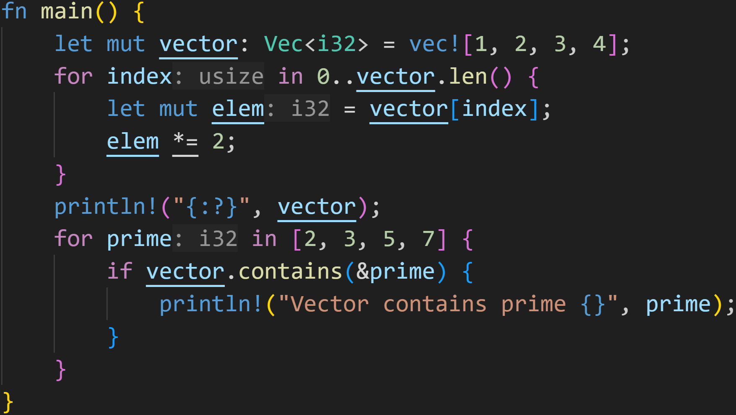
Intermission - Exercises
3/3

Slide 178
Intermission - Exercises
3/3
Does this code compile?
If yes, what does it print?

Slide 179
Intermission - Exercises
3/3
Does this code compile?
If yes, what does it print?
It does compile!
However it does not do what you might think it does...

Slide 180
Intermission - Exercises
3/3
Does this code compile?
If yes, what does it print?
We‘re never actually setting elements in the vector!
We only assign to a local variable.

Slide 181
Intermission - Exercises
3/3
Does this code compile?
If yes, what does it print?
prints [1, 2, 3, 4]

Slide 182
Intermission - Exercises
3/3
Does this code compile?
If yes, what does it print?
vector contains 2 and 3, so it prints those two

Slide 183
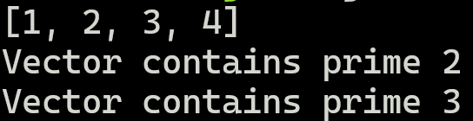
Intermission - Exercises
3/3
Does this code compile?
If yes, what does it print?

Slide 184
Next time
Ownership
Borrow Checker
References

Slide 185
Loops - Extra

Slide 186
Loops - Extra
You might think that there exists the „most powerful“ loop

Slide 187
Loops - Extra
You might think that there exists the „most powerful“ loop
Indeed, some loops are more convenient than others, you would not use loop to iterate over a collection!

Slide 188
Loops - Extra
You might think that there exists the „most powerful“ loop
Indeed, some loops are more convenient than others, you would not use loop to iterate over a collection!
However, all loops can be converted to each other → All loops are equally powerful!

Slide 189
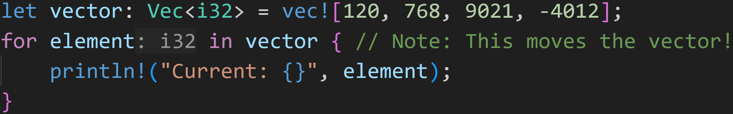
Loops - Extra
Goal: Convert this for loop into a normal loop loop

Slide 190
Loops - Extra
Goal: Convert this for loop into a normal loop loop
Normal loop can‘t easily do the assign thing, we need to first desugar this line

Slide 191
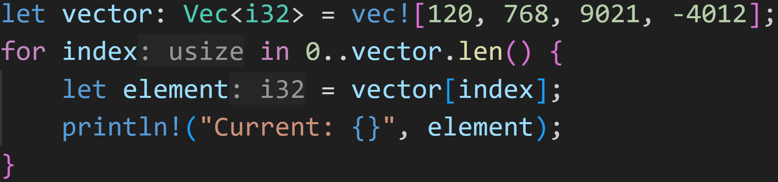
Loops - Extra
Goal: Convert this for loop into a normal loop loop

Slide 192
Loops - Extra
Goal: Convert this for loop into a normal loop loop
Those lines are equivalent – We just assign to a variable by hand
→ Added bonus: We no longer move the vector!

Slide 193
Loops - Extra
Goal: Convert this for loop into a normal loop loop
We‘re still using for though... We need to go deeper!

Slide 194
Loops - Extra
Goal: Convert this for loop into a normal loop loop
We‘re still using for though... We need to go deeper!
We need to understand what the Range does.

Slide 195
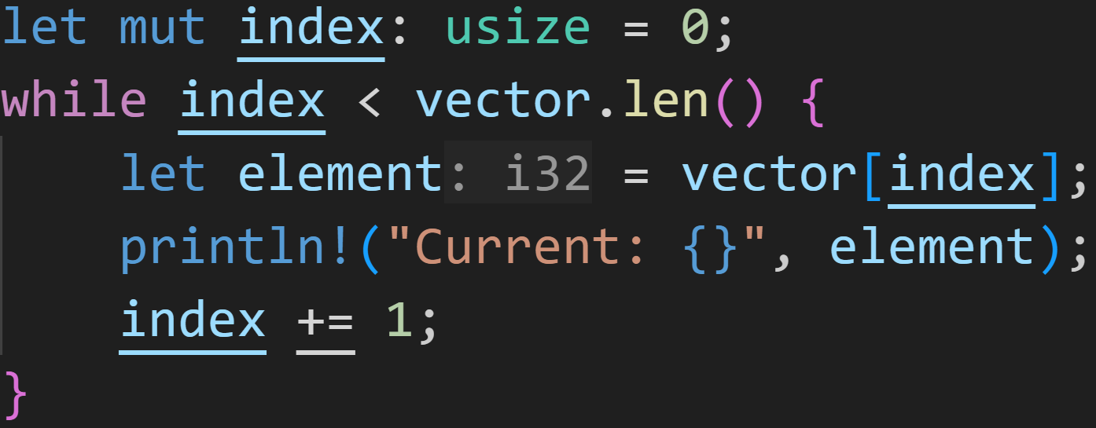
Loops - Extra

Slide 196
Loops - Extra
Where did our range go?

Slide 197
Loops - Extra
Where did our range go?

Slide 198
Loops - Extra
Where did our range go?

Slide 199
Loops - Extra
Where did our range go?

Slide 200
Loops - Extra
Where did our range go?

Slide 201
Loops - Extra
Where did our range go?
Damn, impressive! But we still didn‘t find loop :(

Slide 202
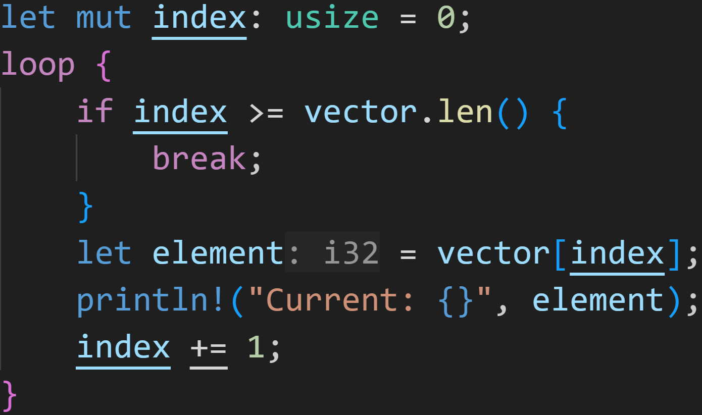
Loops - Extra

Slide 203
Loops - Extra
in while we want to loop as long as the condition is true
→ We want to break the loop once the condition is false
→ not (a < b) → a >= b

Slide 204
Loops - Extra
Here we finally got loop!
All the previous loops are identical in what they do, just using different language constructs.
Exception: for moved the vector, which was not the case in while or loop

Slide 205
Loops - Extra
You might think that there exists the „most powerful“ loop
Indeed, some loops are more convenient than others, you would not use loop to iterate over a collection!
However, all loops can be converted to each other → All loops are equally powerful!
However, as we‘ve seen... It gets quite convoluted. Thank you for and while for existing :^)

Slide 206
Next time
Ownership
Borrow Checker
References

